Slide 1
L3 ii: Virtualization contd…
Prepared by
AVITA KATAL
Assistant Professor
Systemics Cluster
School of Computer Science,UPES

Slide 2
Contents
Taxonomy of virtualization techniques
System Level Virtualization
Hardware-assisted virtualization.
Full virtualization.
Paravirtualization
Partial virtualization.
Hybrid Virtualization
Process Level Virtualization

Slide 3
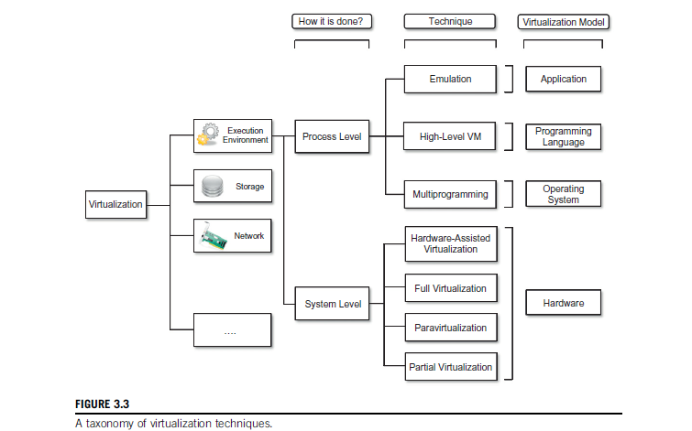
1. Taxonomy of virtualization techniques contd…

Slide 4
2. System Level Virtualization
Hardware Virtualization Techniques
Hardware-assisted virtualization.
Full virtualization.
Paravirtualization
Partial virtualization.
Hybrid Virtualization

Slide 5
2.1. Hardware-assisted virtualization.
The hardware provides architectural support for building a virtual machine manager able to run a guest operating system in complete isolation.
This technique was originally introduced in the IBM System/370.
Examples of hardware-assisted virtualization are the extensions to the x86-64 bit architecture introduced with Intel VT (formerly known as Vanderpool) and AMD V (formerly known as Pacifica).
Before the introduction of hardware-assisted virtualization, software emulation of x86 hardware was significantly costly from the performance point of view.
The reason for this is that by design the x86 architecture did not meet the formal requirements introduced by Popek and Goldberg, and early products were using binary translation to trap some sensitive instructions and provide an emulated version.eg: VMWare Virtual Platform (1999).
Notes:
This term refers to a scenario in which the hardware provides architectural support for building a virtual machine manager able to run a guest operating system in complete isolation. This technique was originally introduced in the IBM System/370. At present, examples of hardware-assisted virtualization are the extensions to the x86-64 bit architecture introduced with Intel VT (formerly known as Vanderpool) and AMD V (formerly known as Pacifica).
These extensions, which differ between the two vendors, are meant to reduce the performance penalties experienced by emulating x86 hardware with hypervisors.
Before the introduction of hardware-assisted virtualization, software emulation of x86 hardware was significantly costly from the performance point of view. The reason for this is that by design the x86 architecture did not meet the formal requirements introduced by Popek and Goldberg, and early products were using binary translation to trap some sensitive instructions and provide an emulated version. Products such as VMware Virtual Platform, introduced in 1999 by VMware, which pioneered the field of x86 virtualization, were based on this technique. After 2006, Intel and AMD introduced processor extensions, and a wide range of virtualiza-tion solutions took advantage of them: Kernel-based Virtual Machine (KVM), VirtualBox, Xen, VMware, Hyper-V, Sun xVM, Parallels, and others.

Slide 6
2.2. Full Virtualization (Hardware Assisted/ Binary Translation )
Virtual machine simulates hardware to allow an unmodified guest OS to be run in isolation.
There is two type of Full virtualizations in the enterprise market. On both full virtualization types, guest operating system’s source information will not be modified.
Software-assisted full virtualization
Hardware-assisted full virtualization
Notes:
Full/Native Virtualization: It is possible to emulate only a section of hardware and use the real-hardware for
the rest. For example: The x86 Xen Full-Virtualized machine would generally emulate the hard drive and use
the real x86 cpu with no emulation. This offers higher performance as you bypass the emulation layer and
use/multiplex the real hardware (with aid from the hypervisor) wherever possible. This also places a constraint
on what kind of virtual machine can be defined. For example: The full-virtualized virtual machine can only be a
x86 instruction compatible when running on a x86 hardware. For example Xen-Full Virtualization, Qemu-x86
Full virtualization refers to the ability to run a program, most likely an operating system, directly on top of a virtual machine and without any modification, as though it were run on the raw hardware.
To make this possible, virtual machine managers are required to provide a complete emulation of the entire underlying hardware.
The principal advantage of full virtualization is complete isolation, which leads to enhanced security, ease of emulation of different architectures, and coexistence of different systems on the same platform.
Whereas it is a desired goal for many virtualization solutions, full virtualization poses important concerns related to performance and technical implementation.
A key challenge is the interception of privileged instructions such as I/O instructions: Since they change the state of the resources exposed by the host, they have to be contained within the virtual machine manager. A simple solution to achieve full virtualization is to provide a virtual environment for all the instructions, thus posing some limits on performance. A successful and efficient implementation of full virtualization is obtained with a combination of hardware and software, not allowing potentially harmful instructions to be executed directly on the host. This is what is accomplished through hardware-assisted virtualization.

Slide 7
2.2.1. Software Assisted – Full Virtualization (BT – Binary Translation )
It completely relies on binary translation to trap and virtualize the execution of sensitive, non-virtualizable instructions sets.
It emulates the hardware using the software instruction sets. Due to binary translation, it often criticized for performance issue.
Here is the list of software which will fall under software assisted (BT).
VMware workstation (32Bit guests)
Virtual PC
VirtualBox (32-bit guests)
VMware Server

Slide 8
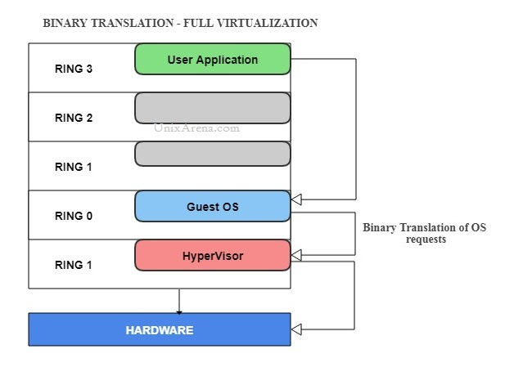

Slide 9
2.2.2 Hardware-Assisted – Full Virtualization (VT)
Hardware-assisted full virtualization eliminates the binary translation and it directly interrupts with hardware using the virtualization technology which has been integrated on X86 processors since 2005 (Intel VT-x and AMD-V).
Guest OS’s instructions might allow a virtual context execute privileged instructions directly on the processor, even though it is virtualized.
A "pure" hardware-assisted virtualization approach, using entirely unmodified guest operating systems, involves many VM traps, and thus high CPU overheads, limiting scalability and the efficiency of server consolidation.
This performance hit can be mitigated by the use of paravirtualized drivers; the combination has been called "hybrid virtualization“
Hardware-assisted virtualization reduces the maintenance overhead of paravirtualization as it reduces (ideally, eliminates) the changes needed in the guest operating system. It is also considerably easier to obtain better performance
Notes:
Uses the same instruction set as that of host instruction set

Slide 10
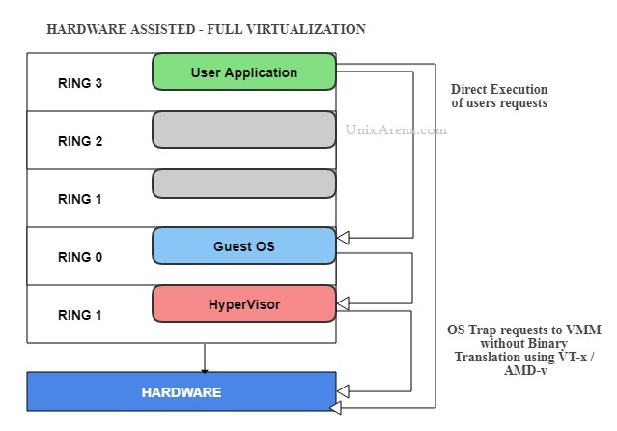

Slide 11
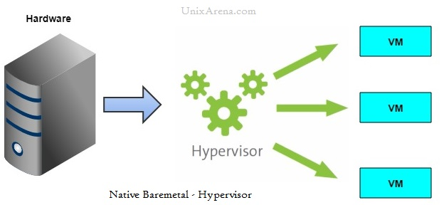
Here is the list of enterprise software which supports hardware-assisted – Full virtualization which falls under hypervisor type 1 (Bare metal )
VMware ESXi /ESX
KVM
Hyper-V
Xen

Slide 12
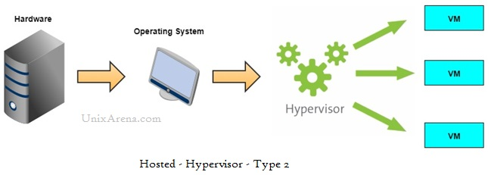
The following virtualization type of virtualization falls under hypervisor type 2 (Hosted).
VMware Workstation (64-bit guests only )
Virtual Box (64-bit guests only )
VMware Server (Retired )

Slide 13
2.3. Paravirtualization
Paravirtualization works differently from the full virtualization. It doesn’t need to simulate the hardware for the virtual machines.
The hypervisor is installed on a physical server (host) and a guest OS is installed into the environment.
Virtual guests aware that it has been virtualized, unlike the full virtualization (where the guest doesn’t know that it has been virtualized) to take advantage of the functions.
In this virtualization method, guest source codes will be modified with sensitive information to communicate with the host.
Guest Operating systems require extensions to make API calls to the hypervisor.
Notes:
Para-Virtualization: There is no hardware simulation/emulation done by the Virtual machine. The virtual
machine uses hypercall API to communicate with the hypervisor for instruction dispatch and other purposes.
The guest OS must be modified to work with the hypercall API. Only opensource OS/Certified OS that can be
modified are suited for para-virtualization. This method places additional constraints on the OS. For example :
Xen-ParaVirtualization
This is a not-transparent virtualization solution that allows implementing thin virtual machine managers. Paravirtualization techniques expose a software interface to the machine that is slightly modified from the host and, as a consequence, guests need to be modified. The aim of paravirtualization is to provide the capability to demand the execution of performance-critical operations directly on the host, thus preventing performance losses that would otherwise be experienced in managed execution. This allows a simpler implementation of virtual machine managers that have to simply transfer the execution of these operations, which were hard to virtualize, directly to the host. To take advantage of such an opportunity, guest operating systems need to be modified and explicitly ported by remapping the performance-critical operations through the virtual machine software interface. This is possible when the source code of the operating sys-tem is available, and this is the reason that paravirtualization was mostly explored in the open-source and academic environment.

Slide 14
2.3. Paravirtualization contd…
In full virtualization, guests will issue a hardware calls but in paravirtualization, guests will directly communicate with the host (hypervisor) using the drivers.
Here is the list of products which supports paravirtualization.
Xen
IBM LPAR
Oracle VM for SPARC (LDOM)
Oracle VM for X86 (OVM)

Slide 15
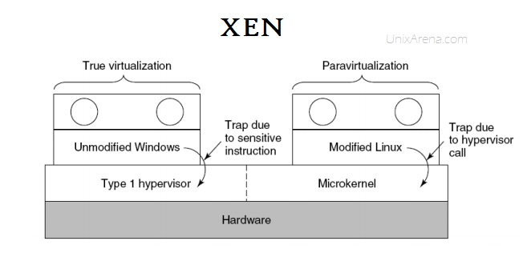
The below diagram might help you to understand how Xen supports both full virtualization and paravirtualization. Due to the architecture difference between windows and Linux based Xen hypervisor, Windows operating system can’t be para-virtualized. But it does for Linux guest by modifying the kernel. But VMware ESXi doesn’t modify the kernel for both Linux and Windows guests.

Slide 16
2.4. Partial virtualization
Partial virtualization provides a partial emulation of the underlying hardware, thus not allowing the complete execution of the guest operating system in complete isolation.
Partial virtualization allows many applications to run transparently, but not all the features of the operating system can be supported, as happens with full virtualization.
An example of partial virtualization is address space virtualization used in time-sharing systems; this allows multiple applications and users to run concurrently in a separate memory space, but they still share the same hardware resources (disk, processor, and network).
Historically, partial virtualization has been an important milestone for achieving full virtualization, and it was implemented on the experimental IBM M44/44X.
Notes:
Partial virtualization provides a partial emulation of the underlying hard-ware, thus not allowing the complete execution of the guest operating system in complete isolation. Partial virtualization allows many applications to run transparently, but not all the features of the operating system can be supported, as happens with full virtualization. An example of partial virtualization is address space virtualization used in time-sharing systems; this allows multiple applications and users to run concurrently in a separate memory space, but they still share the same hardware resources (disk, processor, and network). Historically, partial virtualization has been an important milestone for achieving full virtualization, and it was implemented on the experimental IBM M44/44X. Address space virtualization is a common feature of contemporary operating systems.

Slide 17
2.5. Hybrid Virtualization: ( Hardware Virtualized with PV Drivers )
In Hardware assisted full virtualization, Guest operating systems are unmodified and it involves many VM traps and thus high CPU overheads which limit the scalability.
Paravirtualization is a complex method where guest kernel needs to be modified to inject the API. By considering these issues, engineers have come with hybrid paravirtualization.
It’s a combination of both Full & Paravirtualization.
The virtual machine uses paravirtualization for specific hardware drivers (where there is a bottleneck with full virtualization, especially with I/O & memory intense workloads), and the host uses full virtualization for other features.
The following products support hybrid virtualization.
Oracle VM for x86
Xen
VMware ESXi
Notes:
Hardware not being properly utilized if memory or I/O tasks come as processor will wait according to the access speed of the devices and memory.

